Slide 1



Slide 2

Group 13 - Team Members
Supervisor: Mr. Kiều Trọng Khánh
Team leader: Trần Nguyễn Đăng Khoa
Đặng Ngọc Huy
Nguyễn Hoàng Tân

Slide 3

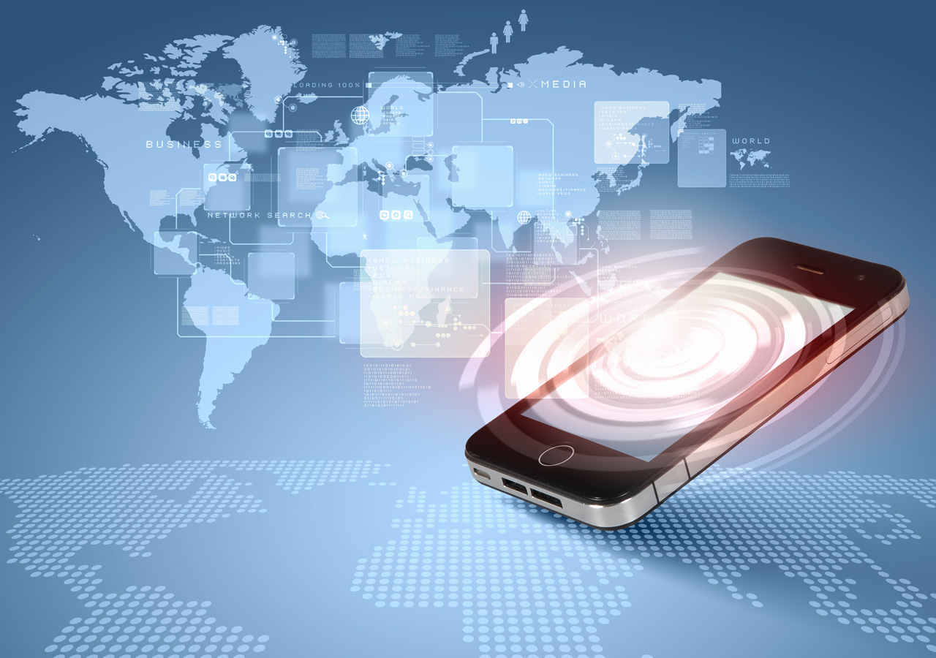
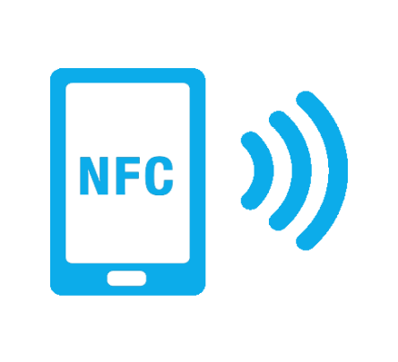
OUTLINE
Scenario problem
Our Solution
Scope
Workflow & Demo
Assessment & Future Plan
Questions and Answers

Slide 4
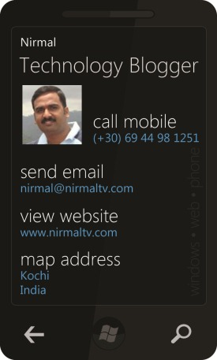
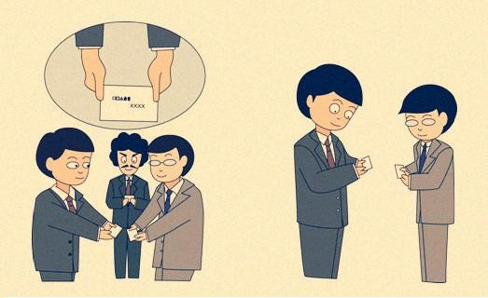
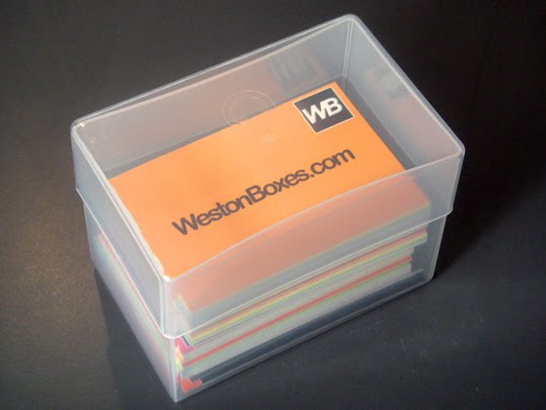


SCENARIO PROBLEM
Notes:
Name Card Exchange in traditional way:
At meeting place, people often exchange their business cards with each other and keep them in some place that when they need, they will search the specific card or they use their eyes to read information and store on their phone contacts book.
When they change their information, they have to re-make their business card and no simple solutions to notify their business partners about the changes.

Slide 5
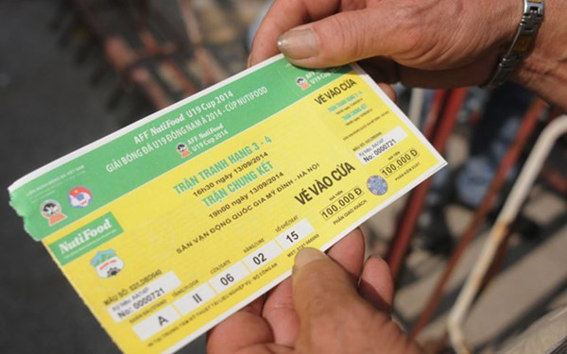
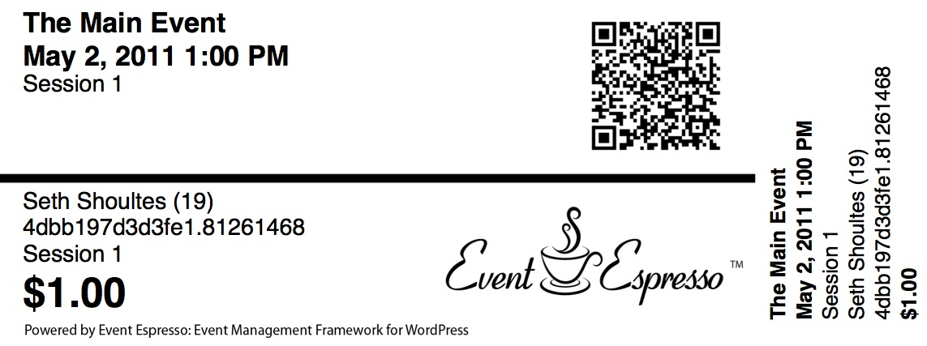
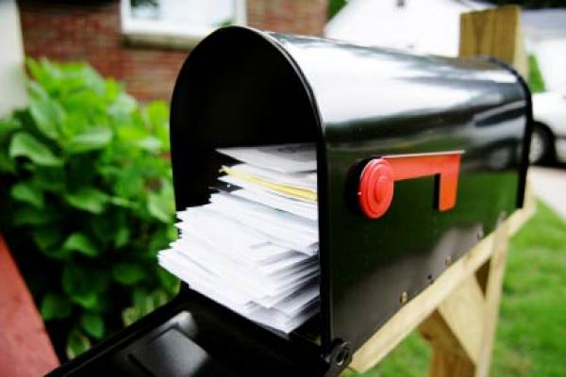
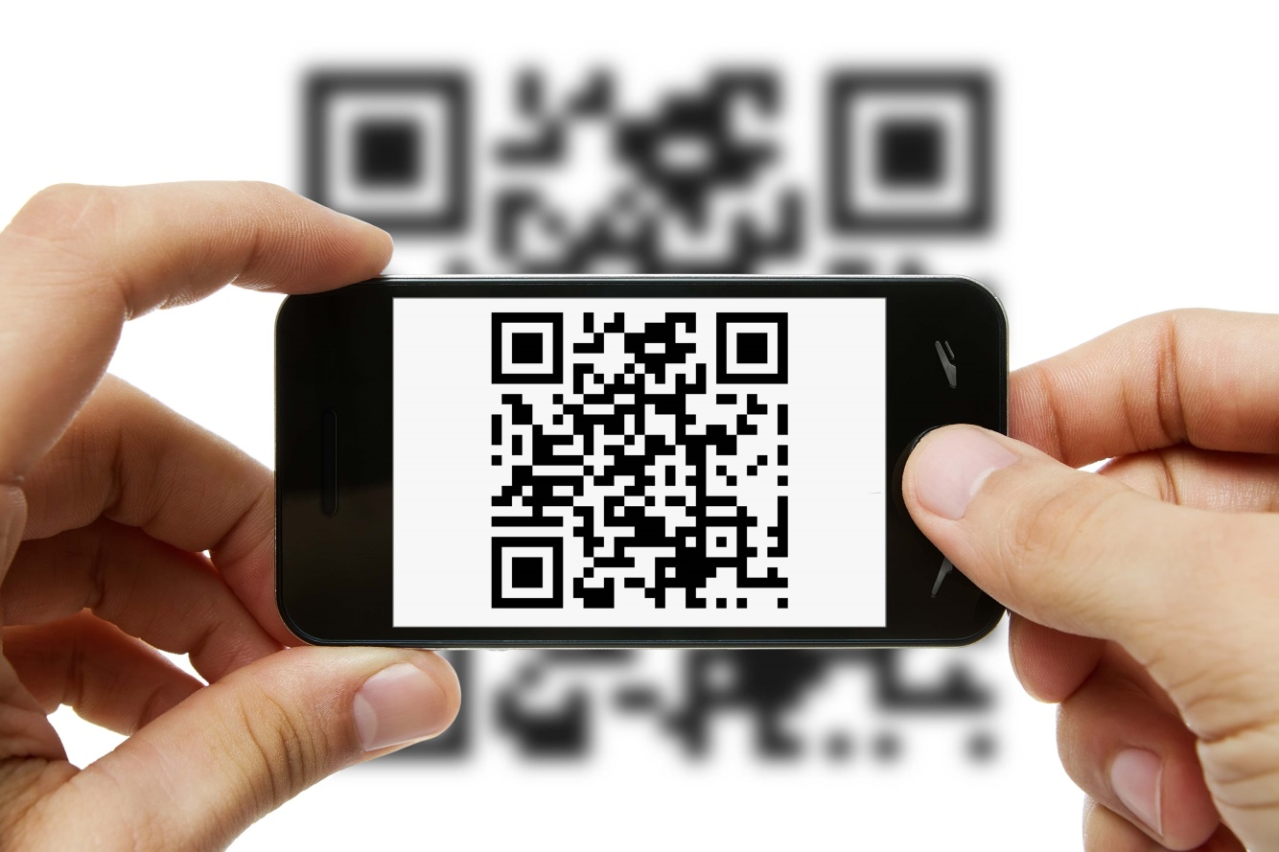

SCENARIO PROBLEM
Notes:
Event ticket in traditional way:
- When buying for an event ticket on some online website, they have to wait for the ticket which is sent by post or some delivery services. The event providers will have to count the ticket after event happened to get statistic information.
- Or they will receive a code (string, bar code, QR code) and bring the code to the entrance gate of event for check-in.

Slide 6

DISADVANTAGES
The process of recognize data by human eyes and transfer it to information is take a lot of time and may be affected by human errors.

Slide 7
NAME CARD - DISADVANTAGES
No centralized approach on the case of changing information
No solution for notify business partner about our updated profile

Slide 8
EVENT TICKET - DISADVANTAGES
Remembering a code may obstruct user. Actual paper ticket may be damaged on delivery or carry, and no real time statics can be count for event providers
The process of scanning QR code, bar code sometime cause bad performance and depend on the quality of the image and the camera.

Slide 9

OUR SOLUTION
Take advantages of NFC feature on Android smart phone to try to solve those disadvantages
Build 1 Web application and 3 Android application

Slide 10
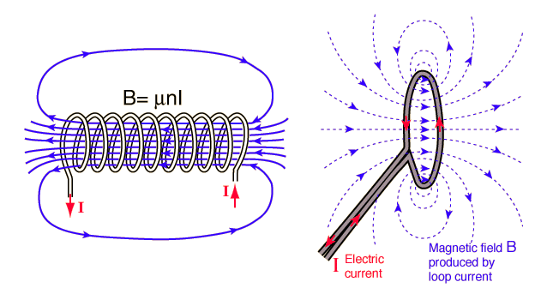
OUR SOLUTION
NFC : Near Field Communication is a wireless technology uses the interaction of electromagnetic waves to transmit data between endpoint devices

Slide 11





OUR SOLUTION

Slide 12


OUR SOLUTION

Slide 13
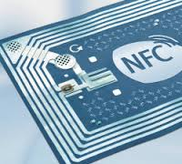
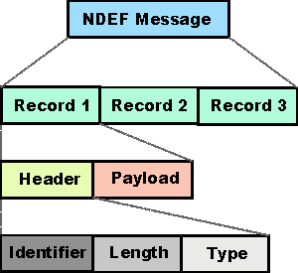
NFC Data Exchange Format
OUR SOLUTION

Slide 14
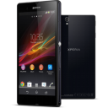




OUR SOLUTION
NDEF

Slide 15
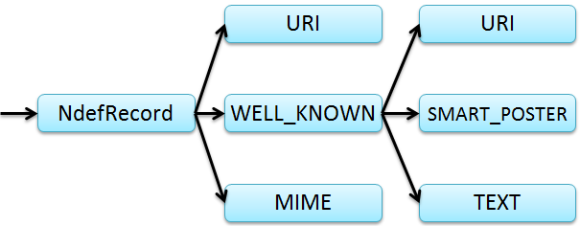
OUR SOLUTION
Name Card: MIME Vcard
Event Ticket : TEXT

Slide 16
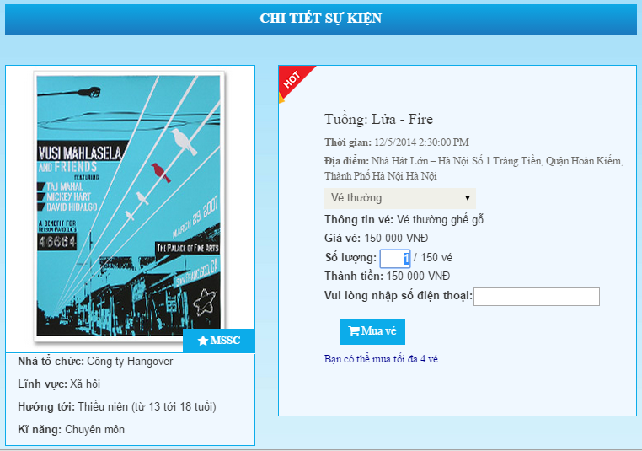
EVENT

Slide 17
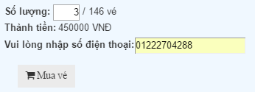


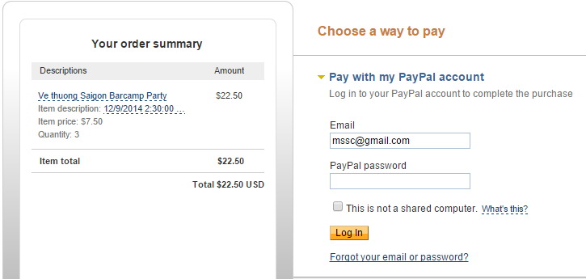
EVENT BOOKING

Slide 18
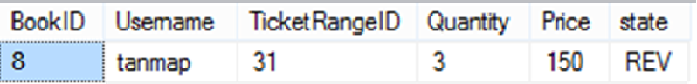
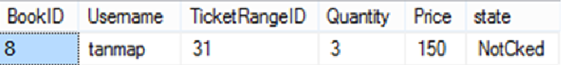
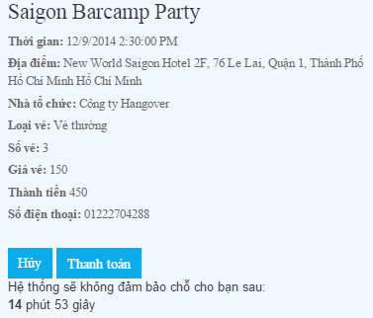
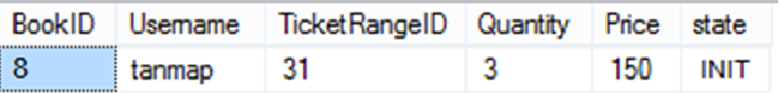
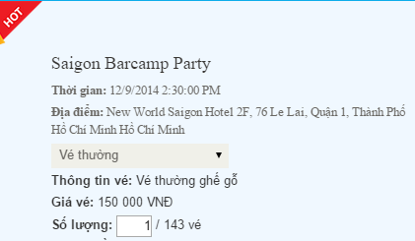
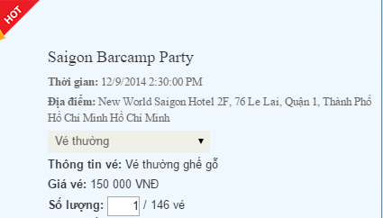
EVENT BOOKING

Slide 19

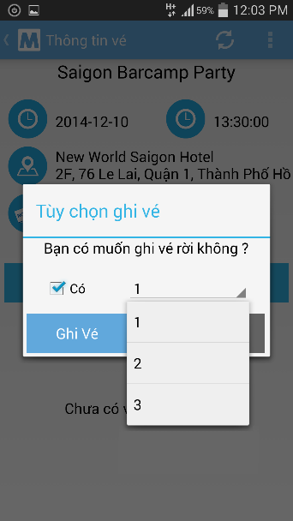

EVENT
8-1
 | BookID | TicketID | Quantity | CheckinDate
 | BookID | TicketID | Quantity | CheckinDate
1 | 8 | 1 | 3 | NULL

Slide 20

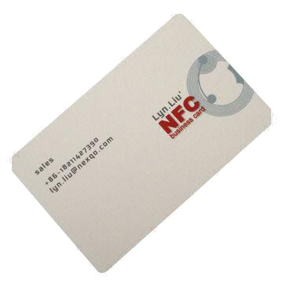
EVENT
8-1

Slide 21
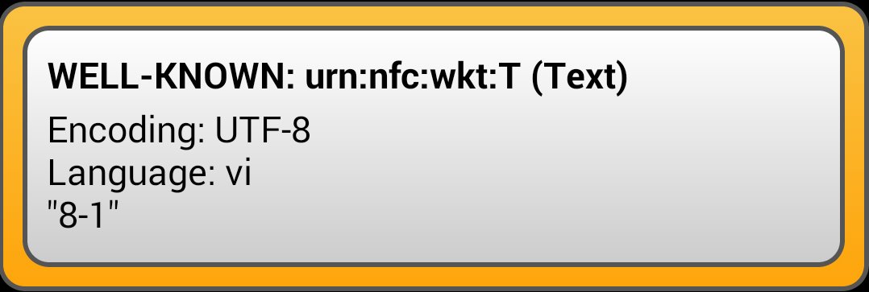
EVENT
Book ID
Ticket ID
 | BookID | TicketID | Quantity | CheckinDate
1 | 8 | 1 | 3 | NULL

Slide 22
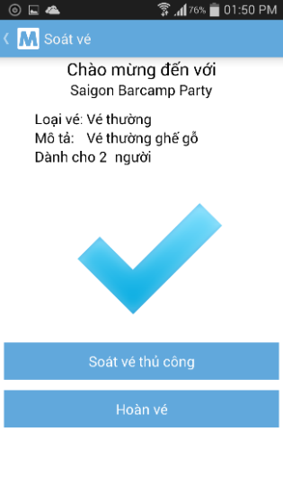

``
EVENT
<BookID>-<TicketID>
 | BookID | TicketID | Quantity | CheckinDate
1 | 8 | 1 | 3 | NULL
2 | 8 | 2 | 4 | NULL
 | BookID | TicketID | Quantity | CheckinDate
1 | 8 | 1 | 3 | 2014-11-20 12:49:20.023
2 | 9 | 1 | 4 | NULL

Slide 23

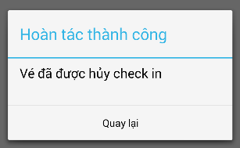
aâ
EVENT
I don’t want to check in this time. Return my ticket, please
10s
 | BookID | TicketID | Quantity | CheckinDate
1 | 8 | 1 | 3 | 2014-11-20 12:49:20.023
2 | 8 | 2 | 4 | NULL
 | BookID | TicketID | Quantity | CheckinDate
1 | 8 | 1 | 3 | NULL
2 | 9 | 1 | 4 | NULL

Slide 24

EVENT SUGGESTION
Guest: Suggest events in same group of viewing event.
Member: Suggest events in most buy group of member.
Notes:
Công nghệ thông tin
Mọi lứa tuổi
Chuyên môn
K Mean Clustering : Group 1
Guest : Suggest Event in Group 1
Member :
- Find the most buy group
- Suggest event in that group

Slide 25
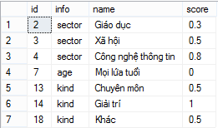
EVENT CLUSTERING USING K-MEANS
Step 1: Digitize Data

Slide 26
EVENT CLUSTERING USING K-MEANS
Step 2: Narrowing data set
Event E1: (“Công nghệ thông tin”, “Mọi lứa tuổi”, “Chuyên môn”)
Event E2: (“Công nghệ thông tin”, “Mọi lứa tuổi”, “Khác”)
Digitize data:
E1 (0.8, 0, 0.5)
E2 (0.8, 0, 0.5)
---> Eliminate duplicate data E2

Slide 27
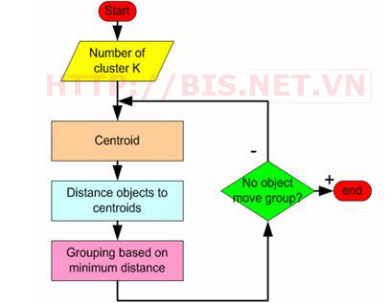
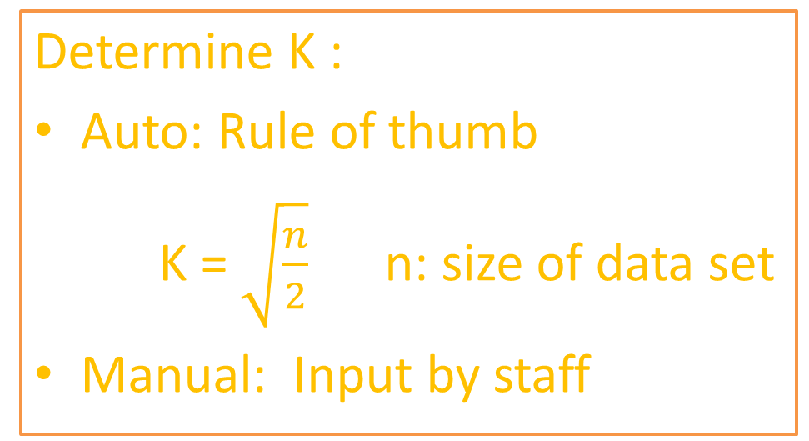
EVENT CLUSTERING USING K-MEANS
Step 3: Apply K-Means Algorithm
Determine K :
Auto: Rule of thumb
K = $\sqrt{\frac{n}{2}}$ n: size of data set
Manual: Input by staff
Notes:
Supervised learning

Slide 28
SCOPE
Web Application: B2B2C selling event tickets
Android Application:
Smart Contact
Event app for Member
Event app for Partner

Slide 29
Admin
Manage Account
Create Staff Account
Smart Contact Management
Booking and write ticket
Configure Clustering
Approve Change Request
Staff
Create and Manage Event
Check Ticket
View Statistic
Register
Booking
Partner
Member
Guest

Slide 30
Work flow

Slide 31



EVENT
Create Event
Purchase
Store
Check-in
Write Ticket

Slide 32
Demo

Slide 33
OUR SOLUTION
Name Card: MIME Vcard
Event Ticket : TEXT

Slide 34
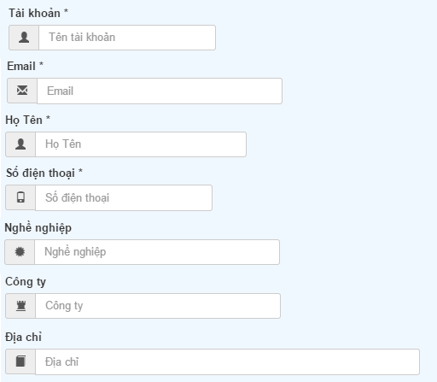
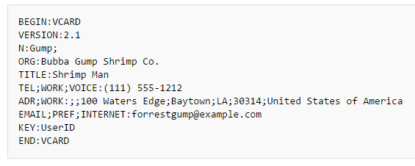
Name Card
Information | Vcard
Tài Khoản | KEY
Email | EMAIL,PREF,INTERNET
Họ Tên | N
Số Điện Thoại | TEL;WORK;VOICE:
Nghề Nghiệp | TITLE
Công Ty | ORG
Địa Chỉ | ADR;WORK
Information | Vcard
Tài Khoản | KEY
Email | EMAIL,PREF,INTERNET
Họ Tên | N
Số Điện Thoại | TEL;WORK;VOICE:
Nghề Nghiệp | TITLE
Công Ty | ORG
Information | Vcard
Tài Khoản | KEY
Email | EMAIL,PREF,INTERNET
Họ Tên | N
Số Điện Thoại | TEL;WORK;VOICE:
Nghề Nghiệp | TITLE
Information | Vcard
Tài Khoản | KEY
Email | EMAIL,PREF,INTERNET
Họ Tên | N
Information | Vcard
Tài Khoản | KEY
Email | EMAIL,PREF,INTERNET
Information | Vcard
Tài Khoản | KEY
Email | EMAIL,PREF,INTERNET
Họ Tên | N
Số Điện Thoại | TEL;WORK;VOICE:
Information | Vcard
Tài Khoản | KEY

Slide 35
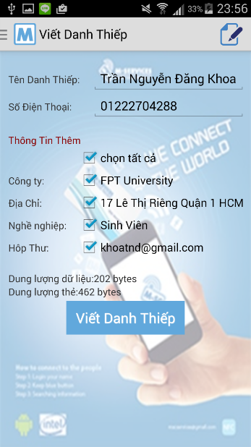
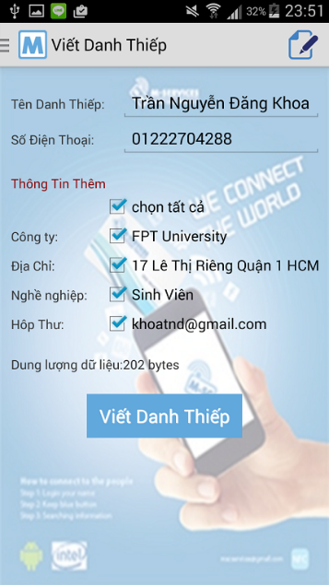
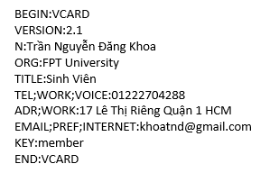
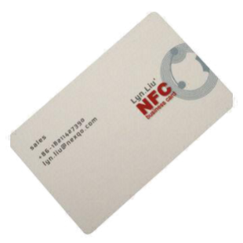

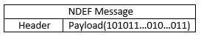
``
Write Name Card

Slide 36
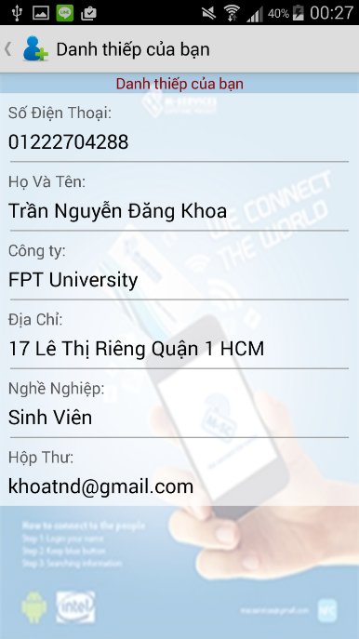
Read Name Card
KEY:member

Slide 37
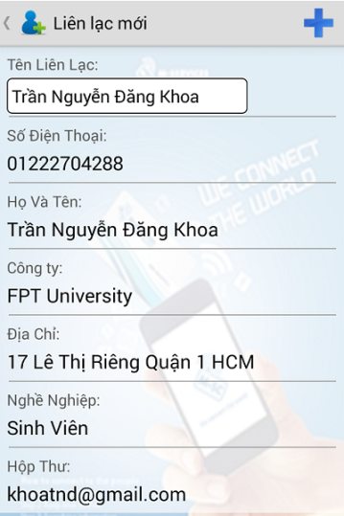

``
Add Name Card
KEY:member
Partner | Alias | Flag | ModifiedDate | isUpdate
member | Trần Nguyễn Đăng Khoa | none | 2014-12-09 00:… | false
Partner | Alias | Flag | ModifiedDate | isUpdate
member | Trần Nguyễn Đăng Khoa | add | 0 | false

Slide 38
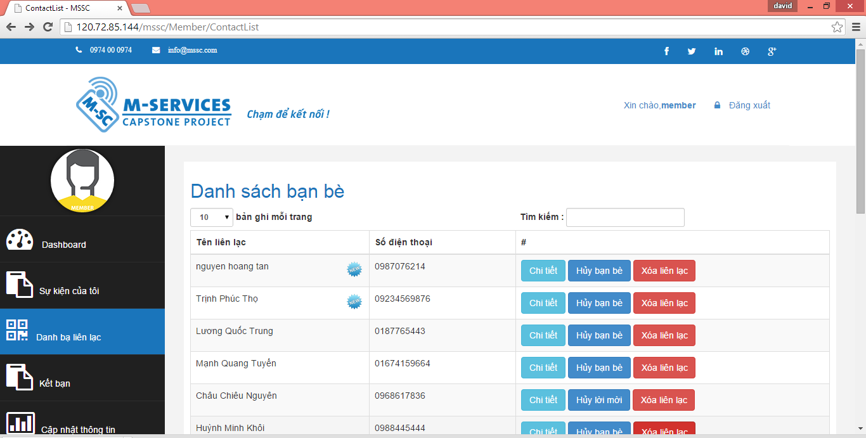
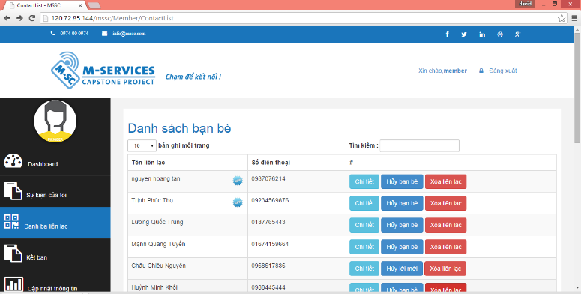
Name Card

Slide 39

Name Card
Save Data
Sync
Unsychronize Data

Slide 40
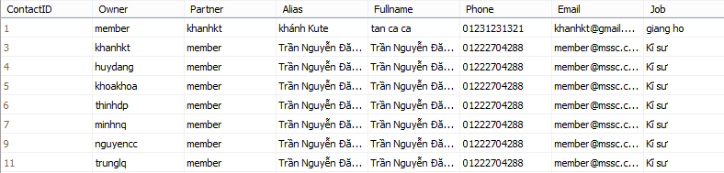
Name Card
Mobile
System
Id | Partner | Alias | Flag | ModifiedDate | isUpdate
1 | huydang | Đặng Ngọc Huy | none | 2014/12/3 12:00: | false
2 | khoakhoa | Khoa Khoa | none | 2014/12/3 12:00: | false
3 | nguyencc | Châu Chiêu Nguyên | none | 2014/9/3 12:00: | false
4 | thinhdb | Đặng Phú Thịnh | none | 2014/12/3 12:00: | false
5 | khoihm | Huỳnh Minh Khôi | none | 2014/12/3 12:00: | false
6 | trunglq | Lương Quốc Trung | none | 2014/12/3 12:00: | false
Id | Partner | Alias | ModifiedDate
1 | huydang | Đặng Ngọc Huy | 2014/12/3 12:00:
2 | Khoakhoa | Khoa Khoa | 2014/12/3 12:00:
3 | nguyencc | Châu Chiêu Nguyên | 2014/9/3 12:00:
4 | thinhdb | Đặng Phú Thịnh | 2014/12/3 12:00:
5 | khoihm | Huỳnh Minh Khôi | 2014/12/3 12:00:
6 | trunglq | Lương Quốc Trung | 2014/12/3 12:00:

Slide 41
Sync Process
Mobile
System
Id | Partner | Alias | Flag | ModifiedDate | isUpdate
1 | huydang | Đặng Ngọc Huy | none | 2014/12/3 12:00: | false
2 | khoakhoa | Khoa Khoa | none | 2014/12/3 12:00: | false
3 | nguyencc | Châu Chiêu Nguyên | none | 2014/9/3 12:00: | false
4 | thinhdb | Đặng Phú Thịnh | none | 2014/12/3 12:00: | false
5 | khoihm | Huỳnh Minh Khôi | none | 2014/12/3 12:00: | false
6 | trunglq | Lương Quốc Trung | remove | 2014/12/3 12:00: | false
7 | tanmap | Nguyễn Hoàng Tân | add | 0 | false
Id | Partner | Alias | ModifiedDate
1 | huydang | Đặng Ngọc Huy | 2014/12/3 12:00:
2 | Khoakhoa | Khoa Khoa | 2014/12/3 12:00:
3 | nguyencc | Châu Chiêu Nguyên | 2014/12/3 12:00:
4 | thinhdb | Đặng Phú Thịnh | 2014/12/3 12:00:
5 | khoihm | Huỳnh Minh Khôi | 2014/12/3 12:00:
6 | trunglq | Lương Quốc Trung | 2014/12/3 12:00:
Sync
Removed Data
New Data
Out-Of-Date Data

Slide 42
Phase 1
:
Mobile
System
Id | Partner | Alias | ModifiedDate
1 | huydang | Đặng Ngọc Huy | 2014/12/3 12:00:
2 | Khoakhoa | Khoa Khoa | 2014/12/3 12:00:
3 | nguyencc | Châu Chiêu Nguyên | 2014/12/3 12:00:
4 | thinhdb | Đặng Phú Thịnh | 2014/12/3 12:00:
5 | khoihm | Huỳnh Minh Khôi | 2014/12/3 12:00:
6 | trunglq | Lương Quốc Trung | 2014/12/3 12:00:
Id | Partner | Alias | Flag | ModifiedDate | isUpdate
1 | huydang | Đặng Ngọc Huy | none | 2014/12/3 12:00: | false
2 | khoakhoa | Khoa Khoa | none | 2014/12/3 12:00: | false
3 | nguyencc | Châu Chiêu Nguyên | none | 2014/9/3 12:00: | false
4 | thinhdb | Đặng Phú Thịnh | none | 2014/12/3 12:00: | false
5 | khoihm | Huỳnh Minh Khôi | none | 2014/12/3 12:00: | false
6 | trunglq | Lương Quốc Trung | remove | 2014/12/3 12:00: | false
7 | tanmap | Nguyễn Hoàng Tân | add | 0 | false
Id | Partner | Alias | ModifiedDate
1 | huydang | Đặng Ngọc Huy | 2014/12/3 12:00:
2 | Khoakhoa | Khoa Khoa | 2014/12/3 12:00:
3 | nguyencc | Châu Chiêu Nguyên | 2014/12/3 12:00:
4 | thinhdb | Đặng Phú Thịnh | 2014/12/3 12:00:
5 | khoihm | Huỳnh Minh Khôi | 2014/12/3 12:00:
6 | trunglq | Lương Quốc Trung | 2014/12/3 12:00:
7 | tanmap | Nguyễn Hoàng Tân | 2014/12/3 12:00:
Id | Partner | Alias | Flag | ModifiedDate | isUpdate
1 | huydang | Đặng Ngọc Huy | none | 2014/12/3 12:00: | false
2 | khoakhoa | Khoa Khoa | none | 2014/12/3 12:00: | false
3 | nguyencc | Châu Chiêu Nguyên | none | 2014/9/3 12:00: | false
4 | thinhdb | Đặng Phú Thịnh | none | 2014/12/3 12:00: | false
5 | khoihm | Huỳnh Minh Khôi | none | 2014/12/3 12:00: | false
6 | trunglq | Lương Quốc Trung | remove | 2014/12/3 12:00: | false
7 | tanmap | Nguyễn Hoàng Tân | none | 2014/12/3 12:00: | false
Sync
7 | tanmap | Nguyễn Hoàng Tân | none | 2014/12/3 12:00: | false
7 | tanmap | Nguyễn Hoàng Tân | 2014/12/3 12:00:

Slide 43
Phase 1
Mobile
System
Id | Partner | Alias | ModifiedDate
1 | huydang | Đặng Ngọc Huy | 2014/12/3 12:00:
2 | Khoakhoa | Khoa Khoa | 2014/12/3 12:00:
3 | nguyencc | Châu Chiêu Nguyên | 2014/12/3 12:00:
4 | thinhdb | Đặng Phú Thịnh | 2014/12/3 12:00:
5 | khoihm | Huỳnh Minh Khôi | 2014/12/3 12:00:
6 | trunglq | Lương Quốc Trung | 2014/12/3 12:00:
7 | tanmap | Nguyễn Hoàng Tân | 2014/12/3 12:00:
Id | Partner | Alias | ModifiedDate
1 | huydang | Đặng Ngọc Huy | 2014/12/3 12:00:
2 | Khoakhoa | Khoa Khoa | 2014/12/3 12:00:
3 | nguyencc | Châu Chiêu Nguyên | 2014/12/3 12:00:
4 | thinhdb | Đặng Phú Thịnh | 2014/12/3 12:00:
5 | khoihm | Huỳnh Minh Khôi | 2014/12/3 12:00:
6 | trunglq | Lương Quốc Trung | 2014/12/3 12:00:
7 | tanmap | Nguyễn Hoàng Tân | 2014/12/3 12:00:
Id | Partner | Alias | Flag | ModifiedDate | isUpdate
1 | huydang | Đặng Ngọc Huy | none | 2014/12/3 12:00: | false
2 | khoakhoa | Khoa Khoa | none | 2014/12/3 12:00: | false
3 | nguyencc | Châu Chiêu Nguyên | none | 2014/9/3 12:00: | false
4 | thinhdb | Đặng Phú Thịnh | none | 2014/12/3 12:00: | false
5 | khoihm | Huỳnh Minh Khôi | none | 2014/12/3 12:00: | false
6 | trunglq | Lương Quốc Trung | remove | 2014/12/3 12:00: | false
7 | tanmap | Nguyễn Hoàng Tân | none | 2014/12/3 12:00: | false
Id | Partner | Alias | ModifiedDate
1 | huydang | Đặng Ngọc Huy | 2014/12/3 12:00:
2 | Khoakhoa | Khoa Khoa | 2014/12/3 12:00:
3 | nguyencc | Châu Chiêu Nguyên | 2014/12/3 12:00:
4 | thinhdb | Đặng Phú Thịnh | 2014/12/3 12:00:
5 | khoihm | Huỳnh Minh Khôi | 2014/12/3 12:00:
7 | tanmap | Nguyễn Hoàng Tân | 2014/12/3 12:00:
Id | Partner | Alias | Flag | ModifiedDate | isUpdate
1 | huydang | Đặng Ngọc Huy | none | 2014/12/3 12:00: | false
2 | khoakhoa | Khoa Khoa | none | 2014/12/3 12:00: | false
3 | nguyencc | Châu Chiêu Nguyên | none | 2014/9/3 12:00: | false
4 | thinhdb | Đặng Phú Thịnh | none | 2014/12/3 12:00: | false
5 | khoihm | Huỳnh Minh Khôi | none | 2014/12/3 12:00: | false
7 | tanmap | Nguyễn Hoàng Tân | none | 2014/12/3 12:00: | false
Sync
6 | trunglq | Lương Quốc Trung | 2014/12/3 12:00:

Slide 44
Phase 2
Mobile
System
Id | Partner | Alias | Flag | ModifiedDate | isUpdate
1 | huydang | Đặng Ngọc Huy | none | 2014/12/3 12:00: | false
2 | khoakhoa | Khoa Khoa | none | 2014/12/3 12:00: | false
3 | nguyencc | Châu Chiêu Nguyên | none | 2014/9/3 12:00: | false
4 | thinhdb | Đặng Phú Thịnh | none | 2014/12/3 12:00: | false
5 | khoihm | Huỳnh Minh Khôi | none | 2014/12/3 12:00: | false
7 | tanmap | Nguyễn Hoàng Tân | none | 2014/12/3 12:00: | false
Id | Partner | Alias | ModifiedDate
1 | huydang | Đặng Ngọc Huy | 2014/12/3 12:00:
2 | Khoakhoa | Khoa Khoa | 2014/12/3 12:00:
3 | nguyencc | Châu Chiêu Nguyên | 2014/12/3 12:00:
4 | thinhdb | Đặng Phú Thịnh | 2014/12/3 12:00:
5 | khoihm | Huỳnh Minh Khôi | 2014/12/3 12:00:
7 | tanmap | Nguyễn Hoàng Tân | 2014/12/3 12:00:
Sync

Slide 45
Phase 2
Mobile
System
Id | Partner | Alias | Flag | ModifiedDate | isUpdate
1 | huydang | Đặng Ngọc Huy | none | 2014/12/3 12:00: | false
2 | khoakhoa | Khoa Khoa | none | 2014/12/3 12:00: | false
3 | nguyencc | Châu Chiêu Nguyên | none | 2014/12/3 12:00: | true
4 | thinhdb | Đặng Phú Thịnh | none | 2014/12/3 12:00: | false
5 | khoihm | Huỳnh Minh Khôi | none | 2014/12/3 12:00: | false
7 | tanmap | Nguyễn Hoàng Tân | none | 2014/12/3 12:00: | false
Id | Partner | Alias | ModifiedDate
1 | huydang | Đặng Ngọc Huy | 2014/12/3 12:00:
2 | Khoakhoa | Khoa Khoa | 2014/12/3 12:00:
3 | nguyencc | Châu Chiêu Nguyên | 2014/12/3 12:00:
4 | thinhdb | Đặng Phú Thịnh | 2014/12/3 12:00:
5 | khoihm | Huỳnh Minh Khôi | 2014/12/3 12:00:
7 | tanmap | Nguyễn Hoàng Tân | 2014/12/3 12:00:
Sync

Slide 46
NAME CARD
Register
Write Contact
Login
Read Contact
Store

Slide 47
Demo

Slide 48

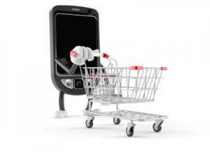

ASSESMENT

Slide 49


FUTURE PLAN

Slide 50










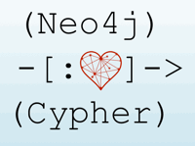

TECHNOLOGIES

Slide 51








DEVELOPMENT ENVIRONMENT

Slide 52
Q&A

Slide 53
THANK YOU FOR YOUR LISTENING

Slide 54
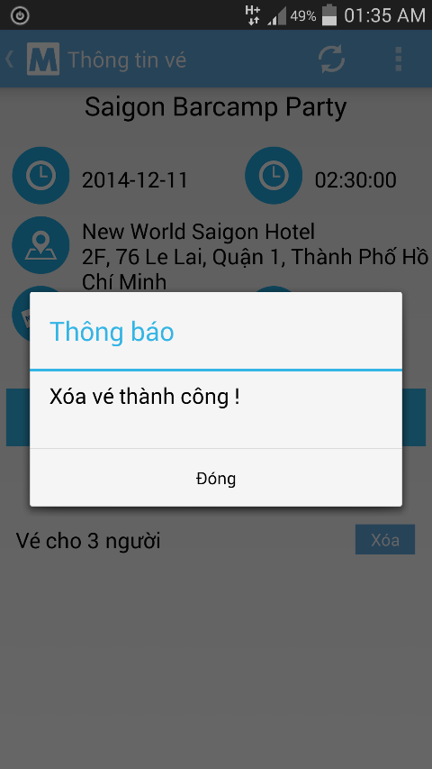
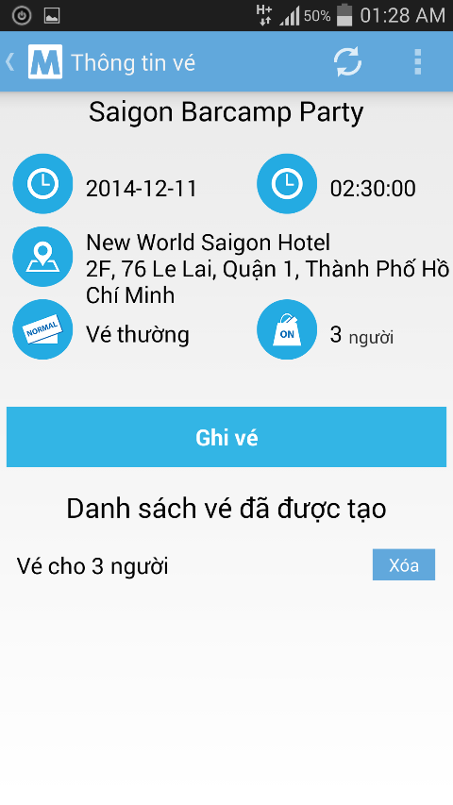
EVENT
 | BookID | TicketID | Quantity | CheckinDate
1 | 8 | 1 | 3 | NULL
2 | 9 | 2 | 4 | NULL
 | BookID | TicketID | Quantity | CheckinDate
2 | 9 | 2 | 4 | NULL

